Slide 1


Slide 2
Group Discussion
DR S.KENNEDY
DEPARTMENT OF TAMIL
ST.JOSEPH’S COLLEGE
TRICHY-2

Slide 3
GD- Design
Objectives of Group Discussion
Definition of Group Discussion
Group Discussion
Why group testing?
Factors that matter in GD
Do’s and Don’ts in Group Discussion
Suggestions
Administrative Details
Topics of importance frequently discussed

Slide 4
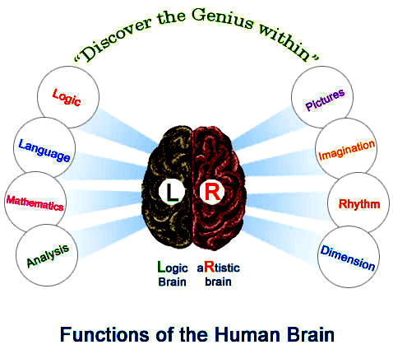

Slide 5
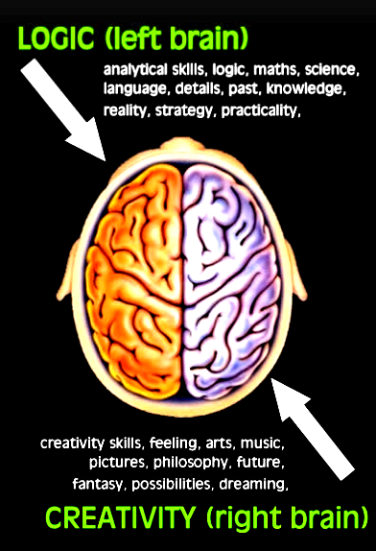

Slide 6
Objective
Students will participate actively in a group setting
Students will share their knowledge with others
Students will improve their communication skills
Students will think as a team and find a solution to a given problem
Students will impress the employers to get a job

Slide 7
Definition of Group Discussion
Group Discussion is a modern method of assessing students personality.
It is both a technique and an art and a comprehensive tool to judge the worthiness of the student and his appropriateness for the job.

Slide 8
WHAT IS GROUP DISCUSSION?
Nowadays Group Discussion is being extensively used along with personal interviews for the final selection of candidates.
It plays a main role in selecting the best among the best. Having scored high marks, students who get selected for a higher/another course or employment are placed on a par - on equal footing - based on their age, qualification and experience.
It becomes necessary to conduct further screening for choosing a few among many. It is here, the Group Discussion plays an important part.
It helps in choosing the socially suitable candidate among the academically superior achievers.

Slide 9
Features Of Group Discussion
It is an exchange of ideas among the individuals of a group on a specific topic.
Group Discussion is an informal discussion in which participants of the same educational standard discuss a topic of current interest.
It is also known as leaderless discussion. It means its aim is to find out the natural leadership level of the candidates.

Slide 10
Group Discussion
It refers to the situation where a particular number of people (three to eight) meet face to face and through free oral interaction, originate, share and discuss ideas to arrive at a decision or solution to a problem.
Group discussions are used for decision-making and problem solving.
They are also used widely as a personality test for evaluating several candidates simultaneously.

Slide 11
NATURE AND SCOPE
The more your ideas and the more your knowledge of the subject, the more interested, enthusiastic and confident you would become and the more fluent and forceful would be your speech and contribution to the discussion.

Slide 12
Categories of Group Discussion
Organizational group discussions
Group discussions as a part of a selection process.

Slide 13
The Nominal Group technique
Restricts discussion or interpersonal communication during the decision-making process
Though group members are all physically present as in a tradition committee meeting, they operate independently

Slide 14
Structure
The group sits in circle or U-shape
They may either be given their choice of seat or seat allotted.
This panel observes and evaluates

Slide 15
Evaluation Components
During a GD employers evaluate potential for leadership and ability to work in a team.
The four components generally evaluated in a group discussion are:
  Knowledge
  Communication skills
  Group behaviour
  Leadership potential

Slide 16
Communication Skills
Candidate assessed in terms of:
Active listening
Clarity of thought and expression
Apt language
body language
Lucidity

Slide 17
Tone: Quality or character of the voice expression a particular feeling or mood
Voice: Power of speech
Articulation: Act of speaking or expressing an idea in words
Fluency: Speaking or writing in an easy, flowing style
Modulation: Variations in rate, tone, or volume of voice
Good delivery: The ideas expressed fluently in the right voice, right tone, and right articulation.
It isn’t sufficient to have ideas. They have to be expressed effectively.

Slide 18
Apt Language
Fluency and accuracy in use of language free from grammatical errors.
Directly, clearly and precisely put ideas in a organized fashion.
Simplicity and unambigusity
Using too much of jargon or high-sounding words or ambiguous expressions may project as a show-off and may not endear to group members.

Slide 19
Effective Use of Body Language
Looking attentively at the speaker and nodding
While speaking, ensuring no one is ignored. Looking at everybody.
Avoiding overt gestures
Avoiding pointing out fingers
Avoiding monotonous posture by shifting slightly in the chair or placing arm on the back of your chair
Not showing interest or dislike in the topic.
Even if one does not like the topic he should try to develop interest and reveal interest and enthusiasm through appropriate facial expression.

Slide 20
Group Behaviour ( Team Spirit)
group behaviour is reflected in ability to interact with other members of the group on brief acquaintance.
Emotional maturity and balance promotes good interpersonal relationships. One is expected to be more people centric and less ego centric.
Remaining objective, empathetic, and non-threatening, and behaving maturely as a good team player

Slide 21
Essence
Consistency participation
Keenness in listening and observing
Time sharing and orderly conduct
Ability to handle turbulent situations
Ability to cut excessively exuberant participants down to size
Ability to dominate the proceedings without bullying others
Avoiding personal comments

Slide 22
Leadership Skills
The success of any team depends to a large extent, on its leader.
The candidate who possesses both functional ability and coordinating ability would emerge as the leader.
Functional ability involves knowledge, mental and physical energy, emotional stability, objectivity, communication skill, integrity and emotional intelligence

Slide 23
Dos
Sitting comfortably
Listening to topic
Organizing ideas
Speaking at the earliest
Identifying supporters/ opponents
Keeping track of time
Sharing time fairly
Maintaining eye contact
Taking notes
Aiming for summary if needed

Slide 24
Don’ts
Moving excessively
Throwing all ideas at one shot
Speaking fast
Digressing
Indulging in ill conversation
Paying attention to bull dozers
Using slang
Getting emotional
Being in a hurry
Being silent
Dominating vocally/physically
Assuming role of chairman
Introducing topic
Taking extreme stance
Looking at faculty

Slide 25

Questions…

Slide 26
Thank you

